Slide 1
Object Oriented Programming in Java Week 12/13

Slide 2
Today
Thread creation
Producer-Consumer
Volatile
Priority queue
Deadlocks

Slide 3
reference
https://docs.oracle.com/javase/tutorial/essential/concurrency/index.html

Slide 4
Java Runtime Memory Areas
Memory area | Stores | Characteristics
Method area | Class variables and bytecodes | Shared among threads
Heap | Objects instance variables | Shared among threads
Stack | Local variables and references | Unique for each thread
PC register | Pointer to current instruction being executed in the method area | Unique for each thread
Other storage: registers, cache
Stack: Last-in first-out data structure
Notes:
Process has
Data statics
Heap
Text – code
Stack
Registers
Resources
Files, locks
Thread is within a process.
Thread has
Text – code, PC
Stack

Slide 5
Thread vs. Runnable
Inheritance should make ‘semantic’ sense
‘Extending thread’ eliminates the possibility for your class to inherit from anything else
start() vs. run()
start()
invoked only on ‘Thread’
Makes a new thread ready to start
run()
invoked on ‘Thread’ or ‘Runnable’
runs in the current thread
Which one is preferable?
Notes:
You can use Thread or Runnable to implement multi-threading. Which one is preferable when all you need to do is override run method?

Slide 6

Thread vs Runnable 1
P
Question: What will print?
public class MultiThreader extends Thread{
@Override
public void run() {
for (int i = 0; i < 3; i++)
System.out.println(Thread.currentThread().getName() + " running.");
}
public static void main(String[] args) {
MultiThreader mt = new MultiThreader();
mt.start();
}
}

Slide 7

Thread vs Runnable 2
P
Question: What will print?
public class MultiThreader extends Thread{
@Override
public void run() {
for (int i = 0; i < 3; i++)
System.out.println(Thread.currentThread().getName() + " running.");
}
public static void main(String[] args) {
MultiThreader mt = new MultiThreader();
mt.run();
}
}

Slide 8
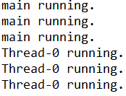
Thread vs Runnable 3
P
Question: What will print?
public class MultiThreader extends Thread{
@Override
public void run() {
for (int i = 0; i < 3; i++)
System.out.println(Thread.currentThread().getName() + " running.");
}
public static void main(String[] args) {
MultiThreader mt = new MultiThreader();
mt.run();
mt.start();
}
}

Slide 9
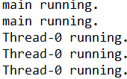
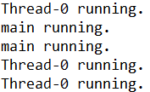
Thread vs Runnable 4
P
Question: What will print?
public class MultiThreader extends Thread{
@Override
public void run() {
for (int i = 0; i < 100; i++)
System.out.println(Thread.currentThread().getName() + " running.");
}
public static void main(String[] args) {
MultiThreader mt = new MultiThreader();
mt.start();
mt.run();
}
}
…

Slide 10
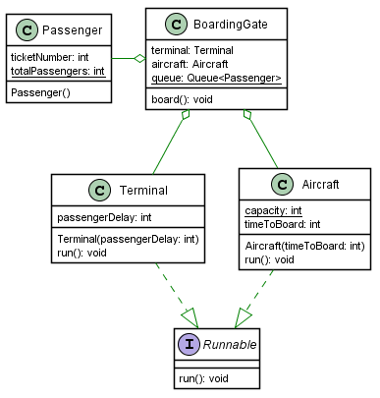

Slide 11
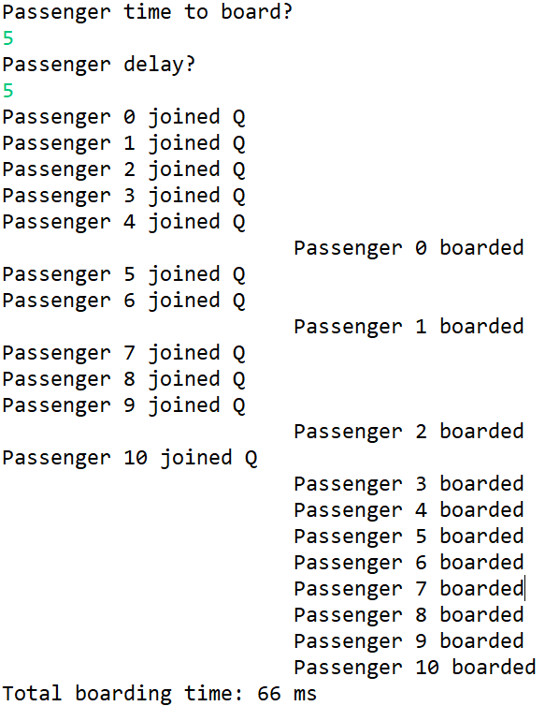
Producer-Consumer 1
Question: Identify producer and consumer
P
BoardingGate is associated with a Terminal
Terminal creates passengers and adds them to queue at the BoardingGate after a random passengerDelay
AirCraft takes a certain timeToBoard for each passenger
The Aircraft has a certain capacity
Aircraft polls BoardingGate.queue as long as it has capacity
Aircraft thread stops when it reaches its capacity
Terminal stops adding passengers when totalPassengers equals Aircraft capacity
Notes:
Other examples: A multithreading program simulates a checkout counter in a shop. The checkout counter has a sales-person to conduct sales transactions for each customer. Customers come to the counter and stand in a queue. The sales-person takes one customer at a time from the head of the queue and completes the sales transaction for that customer. The customer then leaves the queue.

Slide 12
Producer-Consumer 2
P
Question: What should be synchronized?
BoardingGate is associated with a Terminal
The Terminal creates passengers and adds them to queue at the BoardingGate after some random passengerDelay
The AirCraft takes a certain timeToBoard for each passenger
The Aircraft has a certain capacity
Aircraft polls BoardingGate.queue as long as it has capacity
Aircraft thread stops when it reaches its capacity
Terminal stops adding passengers when totalPassengers equals Aircraft capacity

Slide 13
Airport 1
public class BoardingGate{
Terminal terminal;
Aircraft aircraft;
static Queue<Passenger> queue = new LinkedList<>();
public static void main(String[] args) {
BoardingGate boardingGate = new BoardingGate();
Scanner input = new Scanner(System.in);
System.out.println("Passenger time to board?");
boardingGate.aircraft = new Aircraft(input.nextInt());
System.out.println("Passenger delay? ");
boardingGate.terminal = new Terminal(input.nextInt());
boardingGate.board();
input.close();
}
void board() {
Thread thread1 = new Thread(aircraft);
Thread thread2 = new Thread(terminal);
long startTime = System.currentTimeMillis();
thread1.start();
thread2.start();
try {
thread1.join();
thread2.join();
} catch (InterruptedException e) { e.printStackTrace(); }
long endTime = System.currentTimeMillis();
System.out.println("Total boarding time: " + (endTime - startTime) + " ms");
}
}

Slide 14
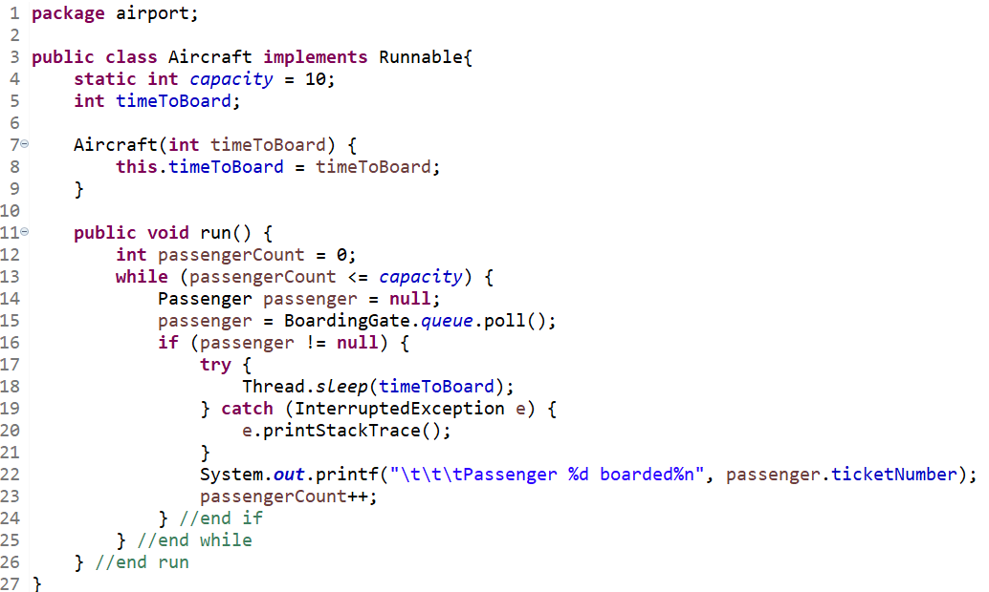
7. Producer-Consumer 3
P
Airport 1
public class Passenger {
int ticketNumber;
static int totalPassengers;
Passenger() {
ticketNumber = totalPassengers++;
}
}
Question: Where should synchronized block begin and end?
synchronized(BoardingGate.queue) {
…
}

Slide 15
Airport 1
public class Terminal implements Runnable{
int passengerDelay;
Terminal(int passengerDelay) {
this.passengerDelay = passengerDelay;
}
@Override
public void run() {
Random random = new Random();
while (Passenger.totalPassengers < Aircraft.capacity) { // < or <=
try {
Thread.sleep(random.nextInt(passengerDelay));
Passenger passenger = new Passenger();
synchronized (BoardingGate.queue) {
BoardingGate.queue.offer(passenger);
System.out.printf("Passenger %d joined Q%n", passenger.ticketNumber);
} //end synchronized
} catch (InterruptedException e) {
e.printStackTrace();
} //end catch
} //end while
} //end run
}

Slide 16
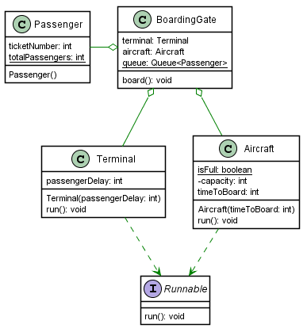
Producer-Consumer
Airport 2
There is a BoardingGate which is associated with a Terminal.
The Terminal creates passengers and adds them to the BoardingGate queue after some random passengerDelay
The AirCraft takes a certain timeToBoard for each passenger
The Aircraft has a certain capacity
The Aircraft polls BoardingGate.queue as long as it has capacity
Aircraft thread stops when it reaches its capacity and sets isFull flag to true
Terminal stops adding passengers when it sees that Aircraft’s isFull flag is set to true

Slide 17
Airport 2
public class Aircraft implements Runnable{
static boolean isFull;
private int capacity = 10;
int timeToBoard;
Aircraft(int timeToBoard) {
this.timeToBoard = timeToBoard;
}
public void run() {
int passengerCount = 0;
while (!isFull) {
Passenger passenger = null;
synchronized(BoardingGate.queue ) {
passenger = BoardingGate.queue.poll();
}
if (passenger != null) {
try {
Thread.sleep(timeToBoard);
} catch (InterruptedException e) {
e.printStackTrace();
}
System.out.printf("\t\t\tPassenger %d boarded%n", passenger.ticketNumber);
passengerCount++;
if (passengerCount >= capacity) isFull = true;
} //end if
} //end while
} //end run
}

Slide 18
Airport 2
public class Terminal implements Runnable{
int passengerDelay;
Terminal(int passengerDelay) {
this.passengerDelay = passengerDelay;
}
@Override
public void run() {
Random random = new Random();
while (!Aircraft.isFull) {
try {
Thread.sleep(random.nextInt(passengerDelay));
Passenger passenger = new Passenger();
synchronized (BoardingGate.queue) {
BoardingGate.queue.offer(passenger);
System.out.printf("Passenger %d joined Q%n", passenger.ticketNumber);
} //end synchronized
} catch (InterruptedException e) {
e.printStackTrace();
} //end catch
} //end while
} //end run
}
public class Passenger {
int ticketNumber;
static int totalPassengers;
Passenger() {
ticketNumber = totalPassengers++;
}
}

Slide 19
VOLATILE
Method area
Method area
Aircraft: static boolean isFull
Aircraft: static volatile boolean isFull
local copy of isFull
run()
run()
run()
run()
Aircraft thread stack
Terminal thread stack
Aircraft thread stack
Terminal thread stack

Slide 20

Queue
public class Passenger {
int loyaltyRating;
String name;
Passenger(int loyaltyRating, String name) {
this.loyaltyRating = loyaltyRating;
this.name = name;
}
}
public class BoardingGate {
Queue<Passenger> q = new LinkedList<>();
public static void main(String[] args) {
BoardingGate bg = new BoardingGate();
bg.buildQueue();
bg.boardPassengers();
}
public void buildQueue() {
q.offer(new Passenger(2, "John"));
q.offer(new Passenger(1, "Sam"));
q.offer(new Passenger(3, "Sara"));
q.offer(new Passenger(1, "Phil"));
q.offer(new Passenger(1, "Kevin"));
q.offer(new Passenger(3, "Bill"));
}
public void boardPassengers() {
while (!q.isEmpty()) {
Passenger next = q.poll();
System.out.printf("%d. %s boarded %n", next.loyaltyRating, next.name);
}
}
}

Slide 21

Priority Queue
public class Passenger implements Comparable<Passenger>{
int loyaltyRating;
String name;
Passenger(int loyaltyRating, String name) {
this.loyaltyRating = loyaltyRating;
this.name = name;
}
@Override
public int compareTo(Passenger o) {
return loyaltyRating - o.loyaltyRating;
}
}
public class BoardingGate {
Queue<Passenger> q = new PriorityQueue<>();
public static void main(String[] args) {
BoardingGate bg = new BoardingGate();
bg.buildQueue();
bg.boardPassengers();
}
public void buildQueue() {
q.offer(new Passenger(2, "John"));
q.offer(new Passenger(1, "Sam"));
q.offer(new Passenger(3, "Sara"));
q.offer(new Passenger(1, "Phil"));
q.offer(new Passenger(1, "Kevin"));
q.offer(new Passenger(3, "Bill"));
}
public void boardPassengers() {
while (!q.isEmpty()) {
Passenger next = q.poll();
System.out.printf("%d. %s boarded %n", next.loyaltyRating, next.name);
}
}
}

Slide 22
deadlocks
// One common scenario for deadlock is when objects are taken in reverse order
class BCell0 {
private Object o1 = new Object();
private Object o2 = new Object();
public void f() {
synchronized(o1) {
synchronized(o2) {
// do work
}
}
}
public void g() {
synchronized(o2) {
synchronized(o1) {
// do work
}
}
}
}

Slide 23
deadlocks
// Another common scenario is when the lock of the parameter object is taken within a synchronized method.
// This may cause a deadlock since getValue and setValue are
// synchronized and are used in swap.
class BCell1 {
private int value;
public synchronized int getValue() { return value; }
public synchronized void setValue(int v) { value = v; }
public synchronized void swap(BCell1 other) {
int temp = getValue();
setValue(other.getValue());
other.setValue(temp);
}
};

Slide 24
deadlocks
// This doesn't cause a deadlock but has memory consistency issue since swap could execute on a and b like a.swap(b) and b.swap(a)
class BCell2 {
private int value;
public synchronized int getValue() { return value; }
public synchronized void setValue(int v) { value = v; }
public synchronized void swap(BCell2 other) {
int temp = value;
value = other.value;
other.value = temp;
}
};

Slide 25
deadlocks
// This doesn't cause a deadlock. This is better because same object executes the swap all the time but may have memory consistency issue if the other object is being mutated at the same time.
// If so, doSwap should probably take the object lock of the other object like synchronized(other). But hashCode() could give inconsistent value if it is not synchronized.
// Then, use System.identityHashCode(Object) which returns a hashcode based on the memory address of the object
class BCell3 {
private int value;
public synchronized int getValue() { return value; }
public synchronized void setValue(int v) { value = v; }
public void swap(BCell3 other) {
if (this == other) return;
else if (this.hashCode() < other.hashCode()) {
doSwap(other);
} else {
other.doSwap(this);
}
}
protected synchronized void doSwap(BCell3 other) {
int temp = value;
value = other.value;
other.value = temp;
}
};
// Better to use more granular Lock objects and use tryLock
// Use atomic variables

Slide 26
CONDITION VARIABLES, NOTIFY, WAIT and other mechanisms
See https://docs.oracle.com/javase/tutorial/essential/concurrency/index.html

Slide 27
Appendix - Volatile
volatile is used to indicate that a variable's value will be modified by different threads.
In a multithreaded application where the threads operate on non-volatile variables, each thread may copy variables from main memory into a CPU cache while working on them, for performance reasons. The problem with threads not seeing the latest value of a variable because it has not yet been written back to main memory by another thread, is called a "visibility" problem. The updates of one thread are not visible to other threads.
Using volatile variables reduces the risk of memory consistency errors, because any write to a volatile variable establishes a happens-before relationship with subsequent reads of that same variable. This means that changes to a volatile variable are always visible to other threads. What's more, it also means that when a thread reads a volatile variable, it sees not just the latest change to the volatile, but also the side effects of the code that led up the change. Using simple atomic variable access is more efficient than accessing these variables through synchronized code, but requires more care by the programmer to avoid memory consistency errors. Whether the extra effort is worthwhile depends on the size and complexity of the application. (https://docs.oracle.com/javase/tutorial/essential/concurrency/atomic.html )
In other words, the main differences between synchronized and volatile are:
a primitive variable may be declared volatile (whereas you can't synchronize on a primitive with synchronized);
an access to a volatile variable never has the potential to block: we're only ever doing a simple read or write, so unlike a synchronized block we will never hold on to any lock;
because accessing a volatile variable never holds a lock, it is not suitable for cases where we want to read-update-write as an atomic operation (unless we're prepared to "miss an update");
a volatile variable that is an object reference may be null (because you're effectively synchronizing on the reference, not the actual object). Attempting to synchronize on a null object will throw a NullPointerException.
You might prefer to use volatile variables instead of locks for one of two principal reasons: simplicity or scalability. Some idioms are easier to code and read when they use volatile variables instead of locks. In addition, volatile variables (unlike locks) cannot cause a thread to block, so they are less likely to cause scalability problems. In situations where reads greatly outnumber writes, volatile variables may also provide a performance advantage over locking.
https://www.ibm.com/developerworks/java/library/j-jtp06197/
Volatile --> Guarantees visibility and NOT atomicity
Synchronization (Locking) --> Guarantees visibility and atomicity (if done properly)
Volatile is not a substitute for synchronization

